Slide 1
CAPI OpenCL Demonstration
Lance Thompson
lancet@us.ibm.com
CAPI Enablement Team
IBM

Slide 2
Session objectives
Understand the changes to an OpenCL host-side application to leverage shared virtual memory and play those changes against a kernel compiled for CAPI
See the process to create a kernel:
compile the kernel for the FPGA
uploading the kernel to the CAPI adapter
See the process to create the host-side application
adjustments to exploit shared virtual memory
“make” the c-code
See the total application execute

Slide 3
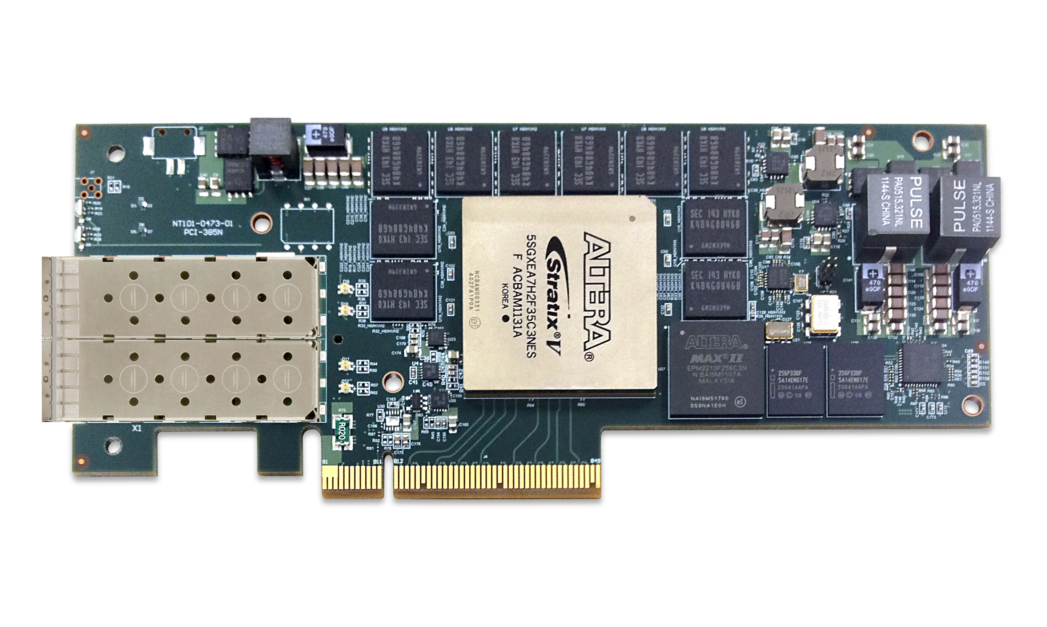
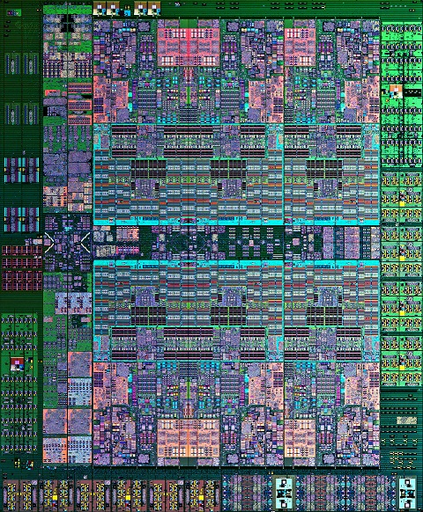
What is CAPI?
CAPI (Coherent Accelerator Processor Interface) is a set of IBM innovations in hardware and software that allow an application and it’s accelerated component to share the same virtual address space.
For customers, CAPI enables performance and ease of programming:
Application to set up data coherently in shared virtual memory and call the accelerator functional unit (AFU)
AFU to reads and writes data from and to shared virtual memory coherently across PCIe and communicating with the application
AFU to coherently cache data in the PSL cache for quick AFU access
See “Acceleration with CAPI: What Makes It Great” (pSY0761) for more depth.
FPGA
AFU
IBM Supplied PSL
Virtual Memory
PCIe
CAPP
Memory (Coherent)
POWER8 Core
OS
App
POWER8 Processor

Slide 4



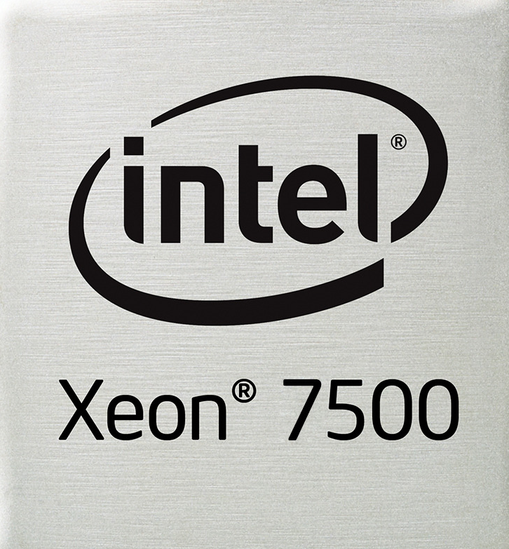
















What is OpenCL?
OpenCL is an open standard programming framework enabling a programmer to code and compile a kernel for a number of architectures like CPU’s, GPU’s, FPGA’s or other processors.
OpenCL provides an abstraction of the hardware allowing software engineers to accelerate algorithms
OpenCL enables flexibility of acceleration approaches
OpenCL enables selection of most effective acceleration platform for your kernel
Allows you to leverage a vast OpenCL ecosystem for accelerated functionality
Multiple FPGA suppliers
Multiple kernel providers
C/C++ API
OpenCL C
Host
Accelerator

Slide 5
What OpenCL 2.0 features exploit CAPI?
On CAPI systems, Shared Virtual Memory (SVM) can be used to share buffers between host and FPGA rather than transferring data to and from private FPGA buffers
Non-CAPI
CAPI
Existing OpenCL host programs need to be modified to use SVM buffers instead of cl_mem objects
Datain transfer from host
Datain
Kernel execution
Dataout
Dataout transfer to host
Datain in shared memory
Kernel execution
Dataout in shared memory

Slide 6

Putting CAPI and OpenCL Together
OpenCL Accelerator Kernels
FPGA
AFU
__kernel void sum
(__global float *a,
__global float *b,
__global float *y)
{
int gid = get_global_id(0);
y[gid] = a[gid] + b[gid];
}
IBM Supplied PSL
Quartus II
Verilog
AOCX
Altera Offline
Compiler
Virtual Memory
PCIe
Sequential Host Code
CAPP
main() {
read_data( … );
manipulate( … );
clEnqueueWriteBuffer( … );
clEnqueueNDRange(…,sum,…);
clEnqueueReadBuffer( … );
display_result( … );
}
Memory (Coherent)
EXE
Standard
gcc Compiler
POWER8 Core
OS
App
POWER8 Processor
Notes:
The way that OpenCL works is typical C sequential host code is written with the OpenCL API to communicate with the accelerator and then
<click>
compiled with a standard compiler like gcc
<click>
The result is an executable that gets run on the host.
Meanwhile the functions that you want to accelerate get placed in a .cl kernel file
<Click>
And compiled with the Altera OpenCL compiler.
<Click>
The object file that gets created is effectively HDL code that gets passed into the Altera Quartus tool and compiled into an executable. All of this is done behind the scenes as part of the compilation process. THe resulting executable is used by the host to program the FPGA during runtime with the resulting acceleration kernels

Slide 7
Usage Overview
Memory operations use OpenCL 2.0 compatible SVM APIS (clSVM….Altera), instead of cl_mem objects
Basic changes needed to hosts using non-shared buffers :
Allocate shared memory buffers with clSVMAllocAltera, free with clSVMFreeAltera
Remove clCreateBuffer /clReleaseMemObject of cl_mem buffers
Remove clEnqueueWriteBuffer/clEnqueueReadBuffer operations
Replace clSetKernelArg with clSetKernelArgSVMPointerAltera
Memory can be assumed to be ready when kernel is finished
clEnqueueSVMMap/clEnqueueSVMUnmap can be called before/after Kernel calls, but have no effect with CAPI

Slide 8
Allocation
Allocating Shared Virtual Memory
// allocate and initialize the input vectors
unsigned * hdatain = (unsigned *)acl_aligned_malloc(sizeof(unsigned) * vectorSize);
unsigned * hdataout = (unsigned *)acl_aligned_malloc(sizeof(unsigned) * vectorSize);
// create the input buffer
cl_mem ddatain = clCreateBuffer(context, CL_MEM_READ_WRITE, sizeof(unsigned) * vectorSize, NULL, &status);
// create the output buffer
cl_mem ddataout = clCreateBuffer(context, CL_MEM_READ_WRITE, sizeof(unsigned) * vectorSize, NULL, &status);
// allocate and initialize the input vectors
unsigned * hdatain = (unsigned *)clSVMAllocAltera(context, 0, sizeof(unsigned) * vectorSize, 1024);
unsigned * hdataout = (unsigned *)clSVMAllocAltera(context, 0, sizeof(unsigned) * vectorSize, 1024);

Slide 9
Arguments
Setting the arguments to the kernel
// set the arguments
status = clSetKernelArg(kernel, 0, sizeof(cl_mem), &ddatain);
status = clSetKernelArg(kernel, 1, sizeof(cl_mem), &ddataout);
// set the arguments
status = clSetKernelArgSVMPointerAltera(kernel, 0, (void*)hdatain);
status = clSetKernelArgSVMPointerAltera(kernel, 1, (void*)hdataout);

Slide 10
Execution
Enqueuing and launching the kernel
status = clEnqueueWriteBuffer(queue, ddatain, CL_FALSE, 0, sizeof(unsigned) * vectorSize, hdatain, 0, NULL, NULL);
status = clEnqueueWriteBuffer(queue, ddataout, CL_FALSE, 0, sizeof(unsigned) * vectorSize, hdataout, 0, NULL, NULL);
status = clEnqueueNDRangeKernel(queue, kernel, 1, NULL, &gsize, &lsize, 0, NULL, NULL);
status = clEnqueueReadBuffer(queue, ddataout, CL_TRUE, 0, sizeof(unsigned) * vectorSize, hdataout, 0, NULL, NULL);
clFinish(queue);
status = clEnqueueNDRangeKernel(queue, kernel, 1, NULL, &gsize, &lsize, 0, NULL, NULL);
clFinish(queue);

Slide 11
Cleanup
Free the Shared Virtual Memory
clReleaseMemObject(ddatain);
clReleaseMemObject(ddataout);
acl_aligned_free(hdatain);
acl_aligned_free(hdataout);
clSVMFreeAltera(context,hdatain);
clSVMFreeAltera(context,hdataout);

Slide 12
Demo
Let’s go live
FFT-1D
Notice the fpga-side does not require any changes
Examine the host-side changes
Compile the fpga-side
Upload the fpga-image to the fpga
Examine the host-side changes
Compile the host-side
Launch the host-side application
Notes:
lancet@yogurt:~/examples/fft1d$ echo $LD_LIBRARY_PATH
/home/lancet/quartus15_143/capi_bsp_v2/host/ppc64le/lib:/home/lancet/quartus15_143/hld/host/ppc64le/lib
lancet@yogurt:~/examples/fft1d$ export CL_CONTEXT_COMPILER_MODE_ALTERA=3

Slide 13
Session summary
The combination of CAPI and OpenCL allow you to more easily leverage the performance potential of FPGA acceleration
fft1d kernel ported from non-CAPI to CAPI in 6 hours (the time to recompile)
fft1d host-side migration was 30 minutes (because I type slow ☺ )
Access points for proof of concept exercises will soon be available:
IBM Power Innovation Cluster
Texas Advanced Computing Center
CAPI Developer Kits are available through Nallatech
http://www.nallatech.com/solutions/openpower-capi-developer-kit-for-power-8/
Contact Altera for beta access to CAPI OpenCL
lancet@us.ibm.com

Slide 14
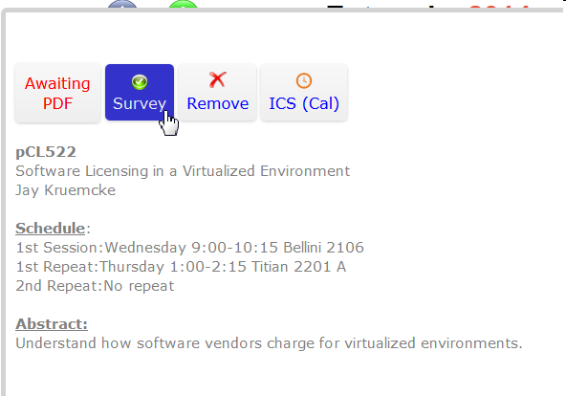
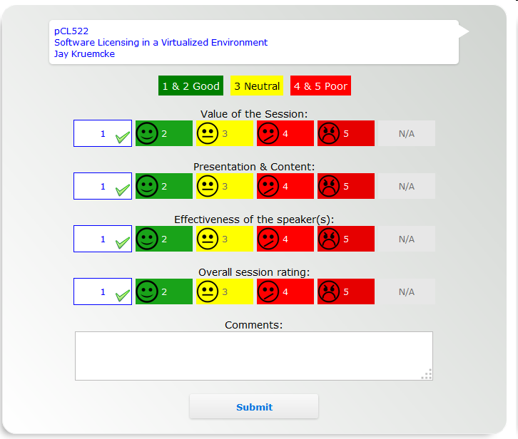
Please fill out an evaluation!
@ IBMtechU
Some great prizes
to be won!

Slide 15







Continue growing your IBM skills
ibm.com/training provides a comprehensive portfolio of skills and career accelerators that are designed to meet all your training needs.
Training in cities local to you - where and when you need it, and in the format you want
Use IBM Training Search to locate public training classes near to you with our five Global Training Providers
Private training is also available with our Global Training Providers
Demanding a high standard of quality – view the paths to success
Browse Training Paths and Certifications to find the course that is right for you
If you can’t find the training that is right for you with our Global Training Providers, we can help.
Contact IBM Training at dpmc@us.ibm.com
Global Skills Initiative

Slide 16
Backup Material

Slide 17
OpenCL Compile
aoc
$ aoc device/fft1d.cl --fpc --no-interleaving default --board 385_a7_capi -v
aoc: Environment checks are completed successfully.
You are now compiling the full flow!!
aoc: Selected target board 385_a7_capi
aoc: Running OpenCL parser....
aoc: OpenCL parser completed successfully.
aoc: Compiling....
aoc: Linking with IP library ...
aoc: First stage compilation completed successfully.
Warning: Unknown platform type, no auto migration performed
aoc: Hardware generation completed successfully.
$

Slide 18
Upload the kernel
capi_flash.sh
lancet@yogurt:~/examples/fft1d$ sudo ~/bin/capi_flash.sh bin/fft1d.rbf
[sudo] password for lancet:
Device ID: 0477
Vendor ID: 1014
VSEC Length/VSEC Rev/VSEC ID: 0x08001280
Version 0.12
Programming User Partition with bin/fft1d.rbf
Program -> for Size: 128 in blocks (32K Words or 128K Bytes)
Erasing Flash
....................
Programming Flash
Writing Buffer: 16511
Verifying Flash
Reading Block: 128
Erase Time: 121 seconds
Program Time: 27 seconds
Verify Time: 17 seconds
Total Time: 165 seconds
Preparing to reset card
Sleeping 30 seconds for reset to occur
lancet@yogurt:~/examples/fft1d$

Slide 19
Execute host-side application
fft1d
lancet@yogurt:~/examples/fft1d$ ./bin/fft1d
Using AOCX: fft1d.aocx
Reprogramming device with handle 1
Launching FFT transform for 2000 iterations
FFT kernel initialization is complete.
Processing time = 443.1795ms
Throughput = 0.0185 Gpoints / sec (1.1091 Gflops)
Signal to noise ratio on output sample: 30.322758 --> FAILED
Launching inverse FFT transform for 2000 iterations
Inverse FFT kernel initialization is complete.
Processing time = 440.3404ms
Throughput = 0.0186 Gpoints / sec (1.1162 Gflops)
Signal to noise ratio on output sample: 130.668122 --> PASSED
lancet@yogurt:~/examples/fft1d$

